Slide 1
BRIEF ACCOUNT OF GILLS IN VERTEBRATES
BY
DR SHAVISH VAID
(LECTURER)
DEPT. OF ZOOLOGY,
GOVT. P. G. COLLEGE,
RAJOURI

Slide 2
A gill is a respiratory organ found in many aquatic organisms that extracts dissolved oxygen from water and excretes carbon dioxide. The gills of vertebrates typically develop in the walls of the pharynx, along a series of gill slits opening to the exterior.
Most species employ a countercurrent exchange system to enhance the diffusion of substances in and out of the gill, with blood and water flowing in opposite directions to each other. The gills are composed of comb-like filaments, the gill lamellae, which help increase their surface area for oxygen exchange.

Slide 3
Gills in Protochordates
A large and sieve-like pharynx in majority of these animals performs dual function of respiration and trapping food particles which are brought in through the current of water.
Balanoglossus possesses a large pharynx having as many as 700 pairs of gill slits, which appears to be a necessity in the burrowing habitat of the animal.
The free-living urochordates, such as Salpa and Doliolum do not possess many stigmata or gill slits as their entire body is permeable to oxygen but in the sedentary ascidians pharynx is prominently enlarged and perforated with no less than 200,000 stigmata for filter-feeding.
Cephalochordates use pharynx for both filter-feeding and respiration and hence carry 150-200 pairs of gill slits.

Slide 4
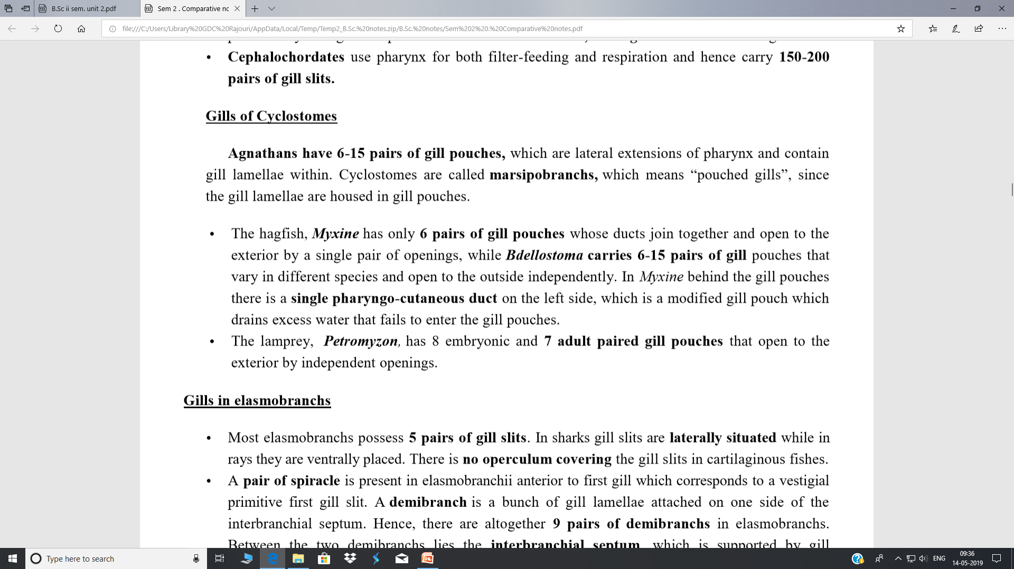

Slide 5
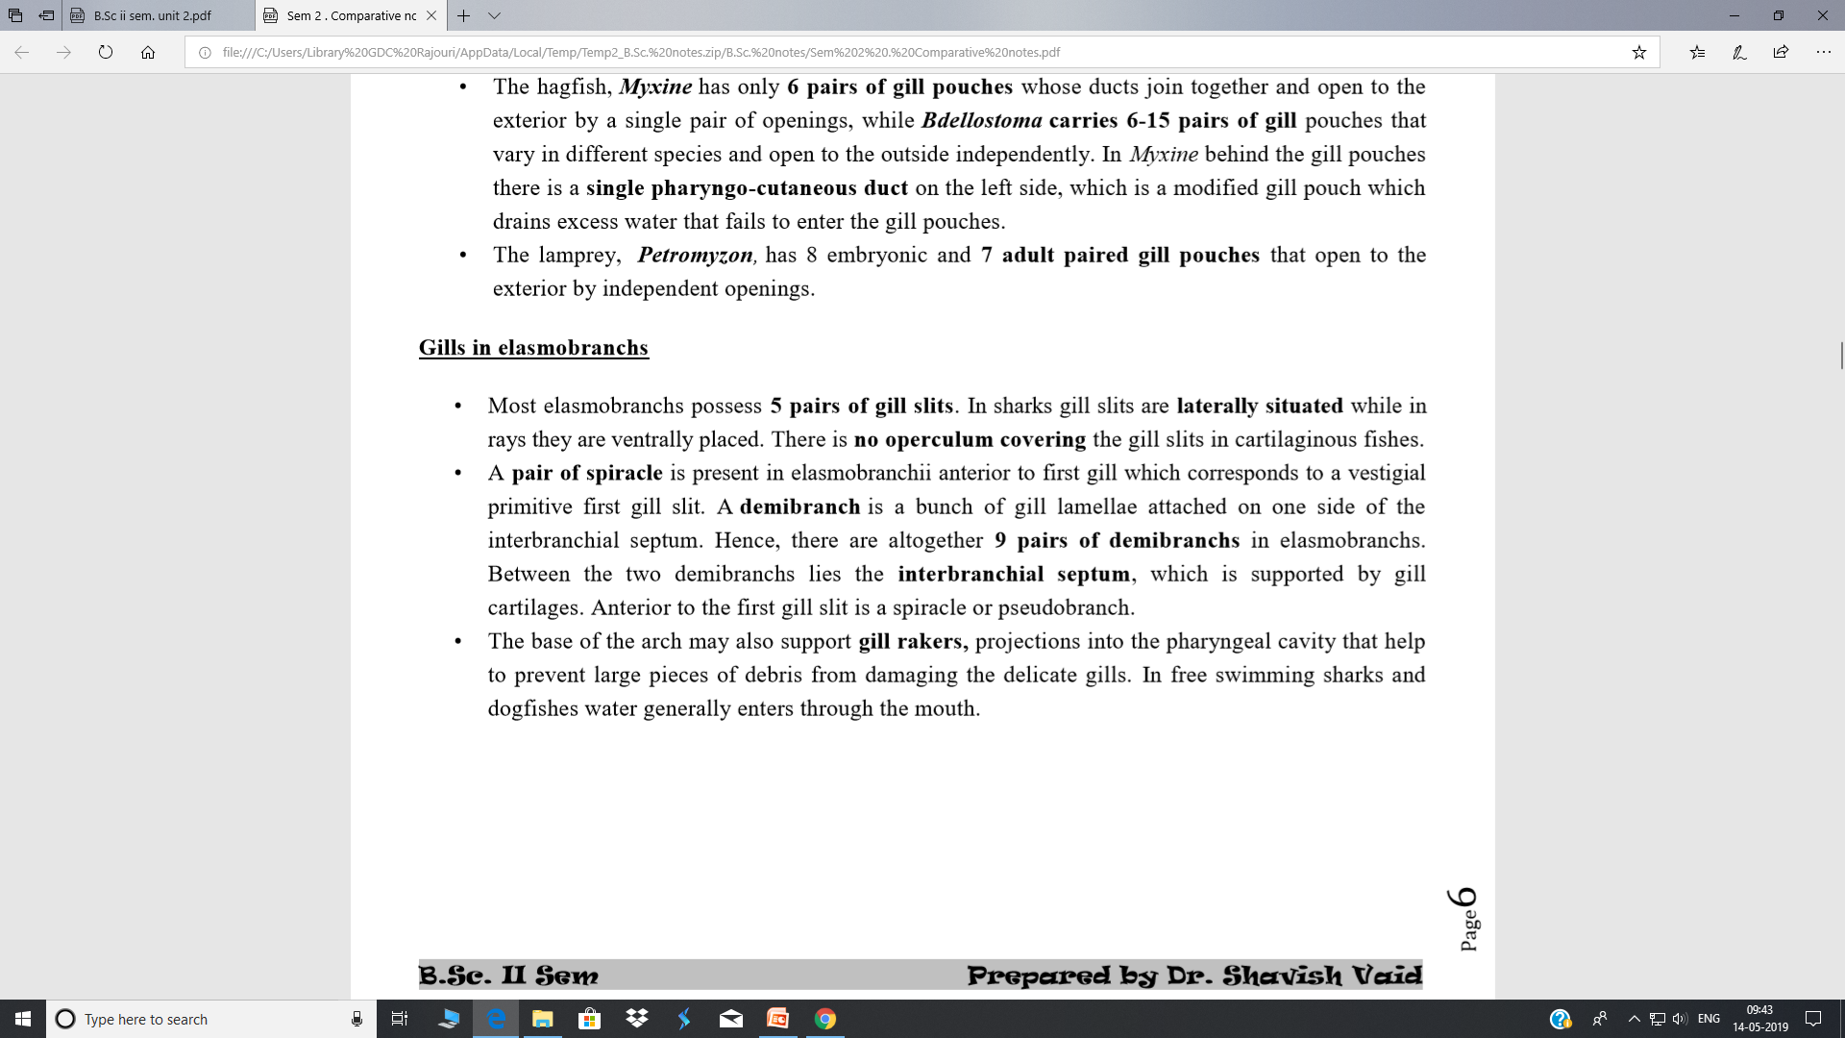

Slide 6
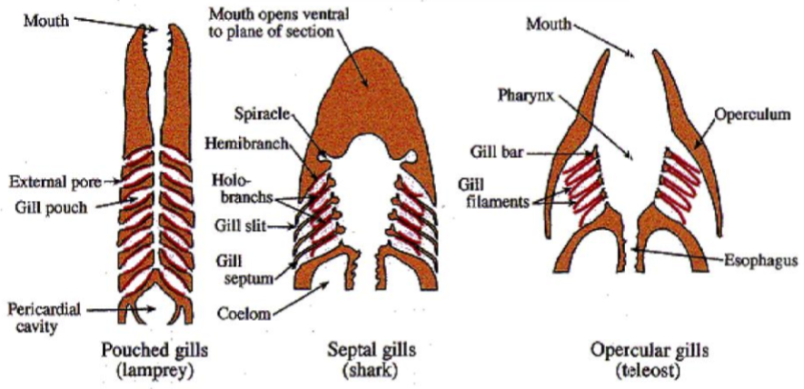

Slide 7
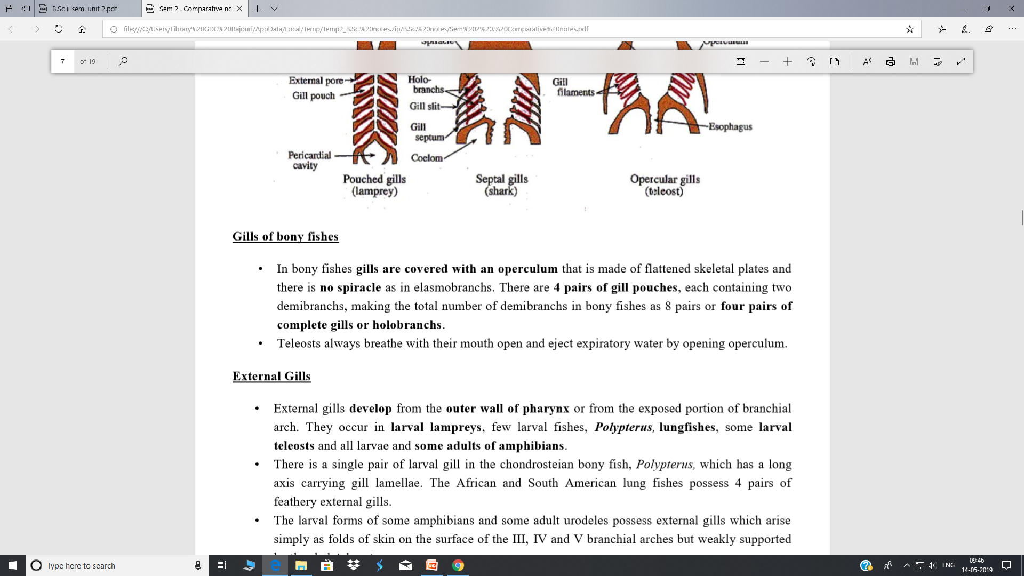

Slide 8
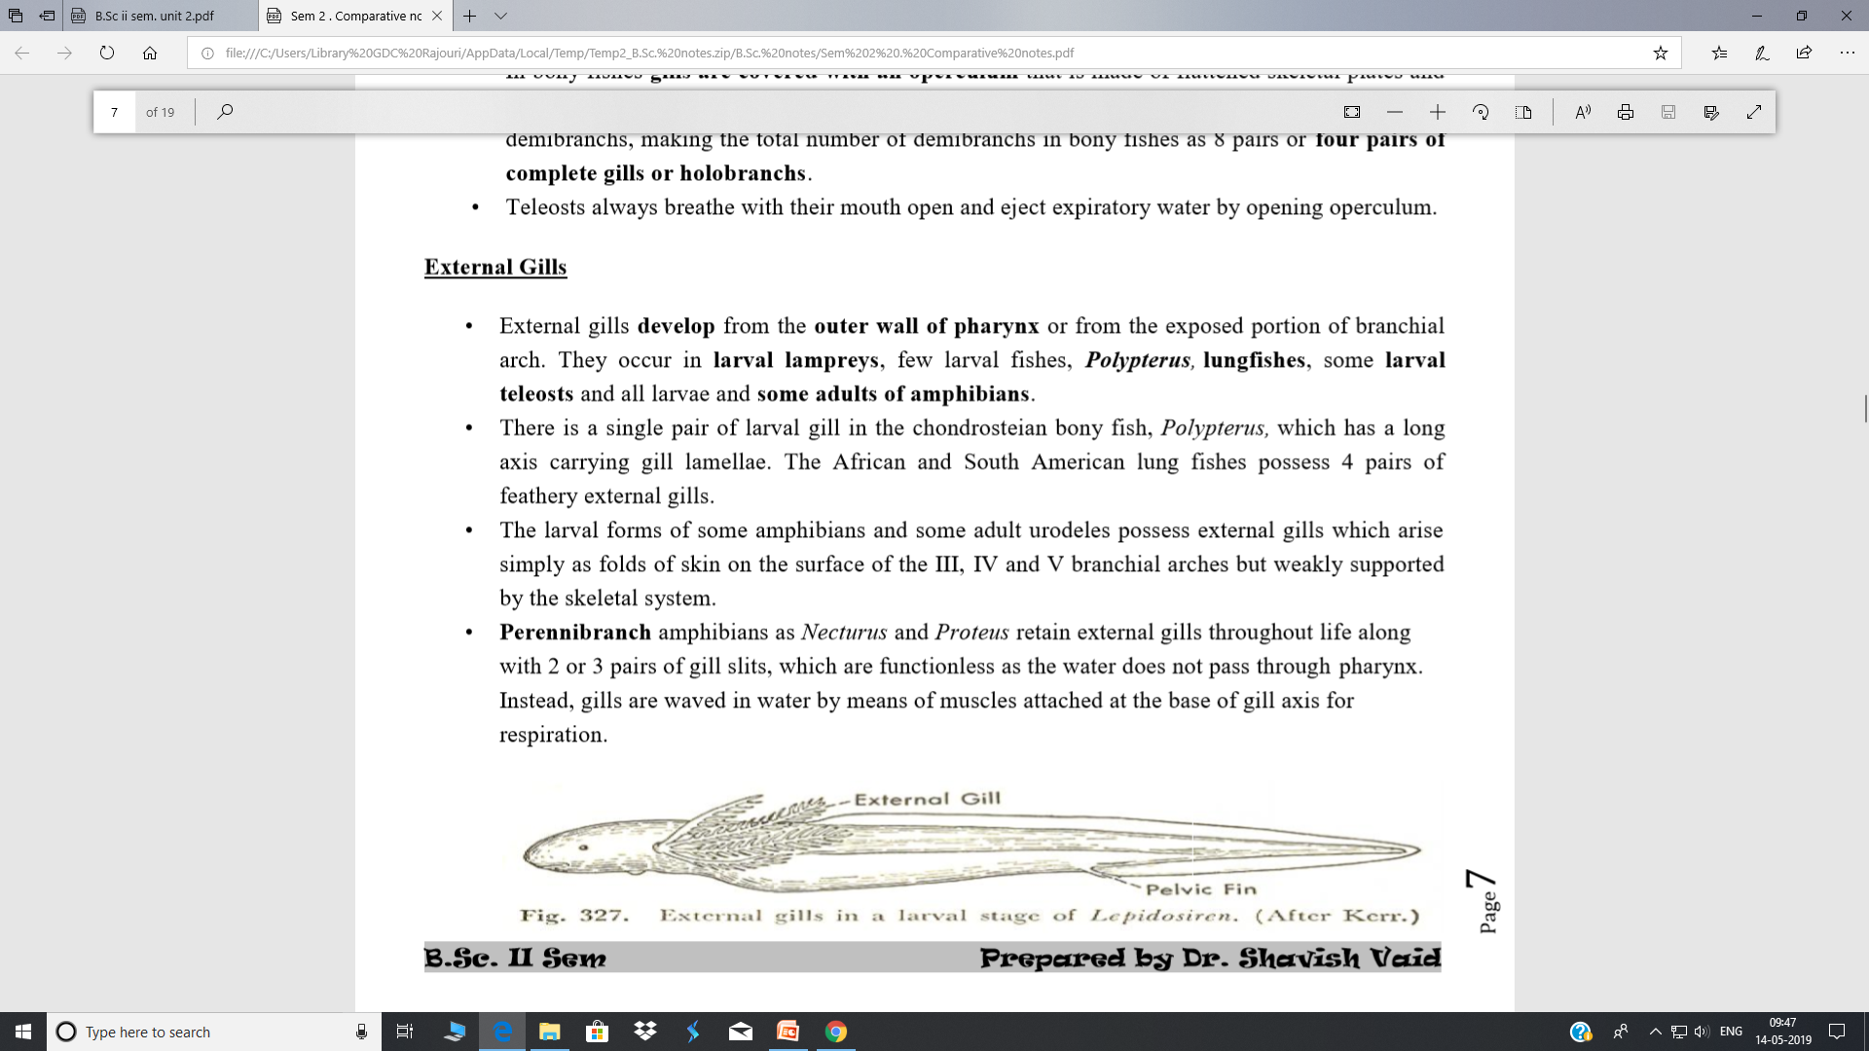

Slide 9
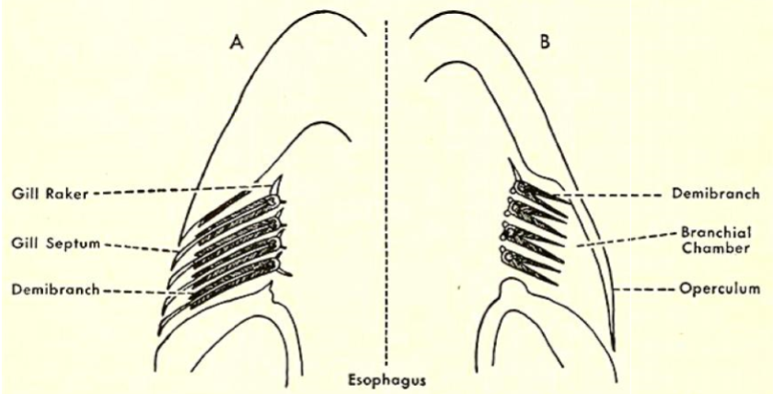
Structure of gills: A) In elasmobranchs B) In bony fishes

Slide 10
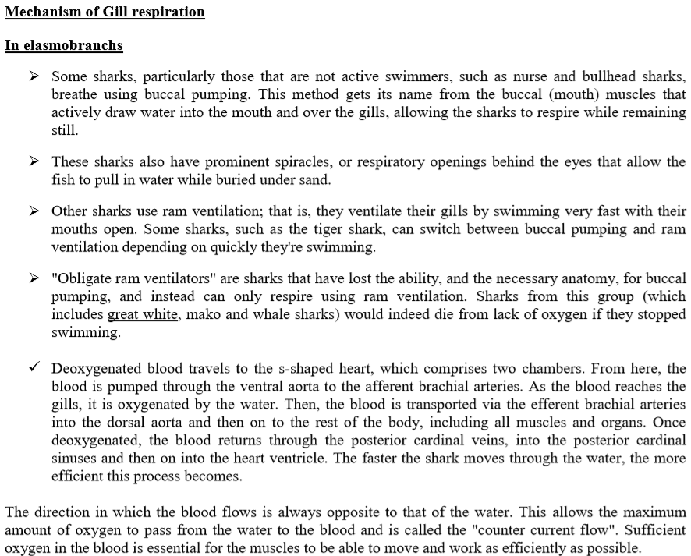

Slide 11
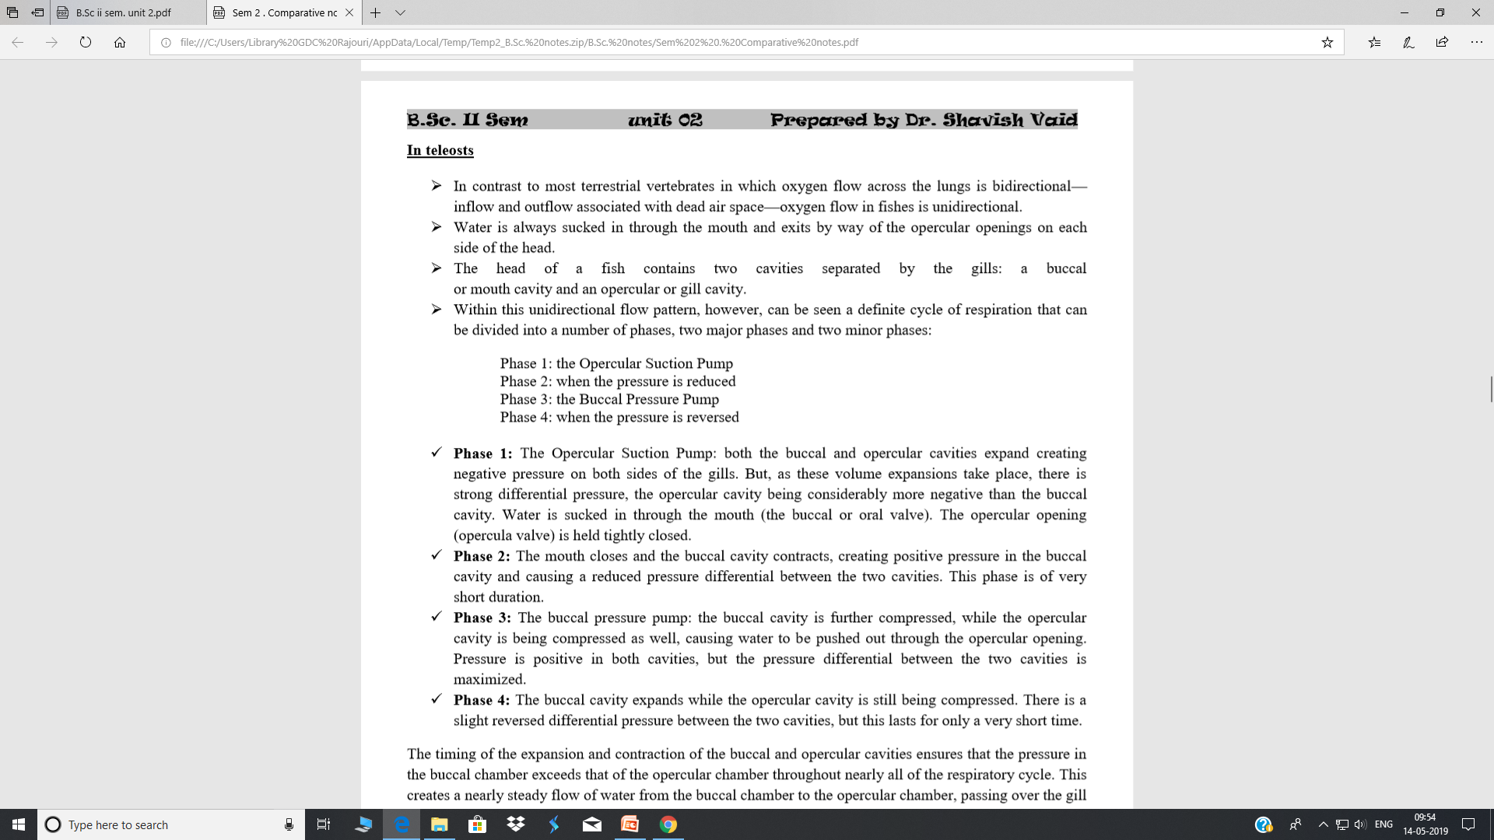

Slide 12
